Slide 1

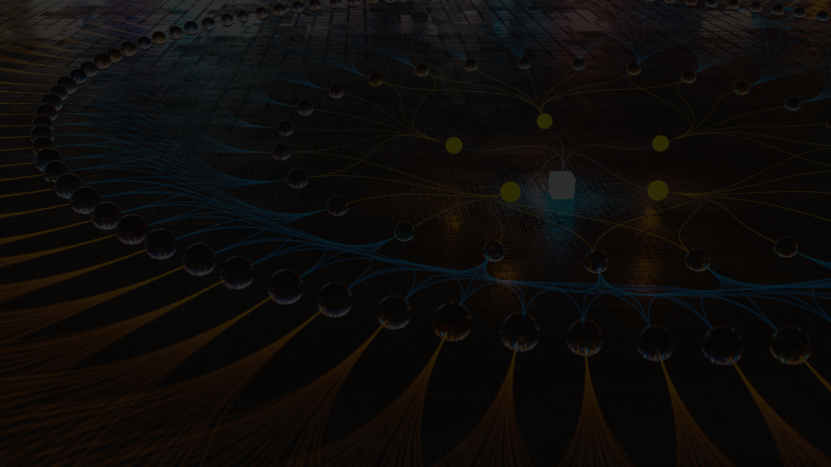
QUANTUM
COMPUTING
A Brief Intro

Slide 2

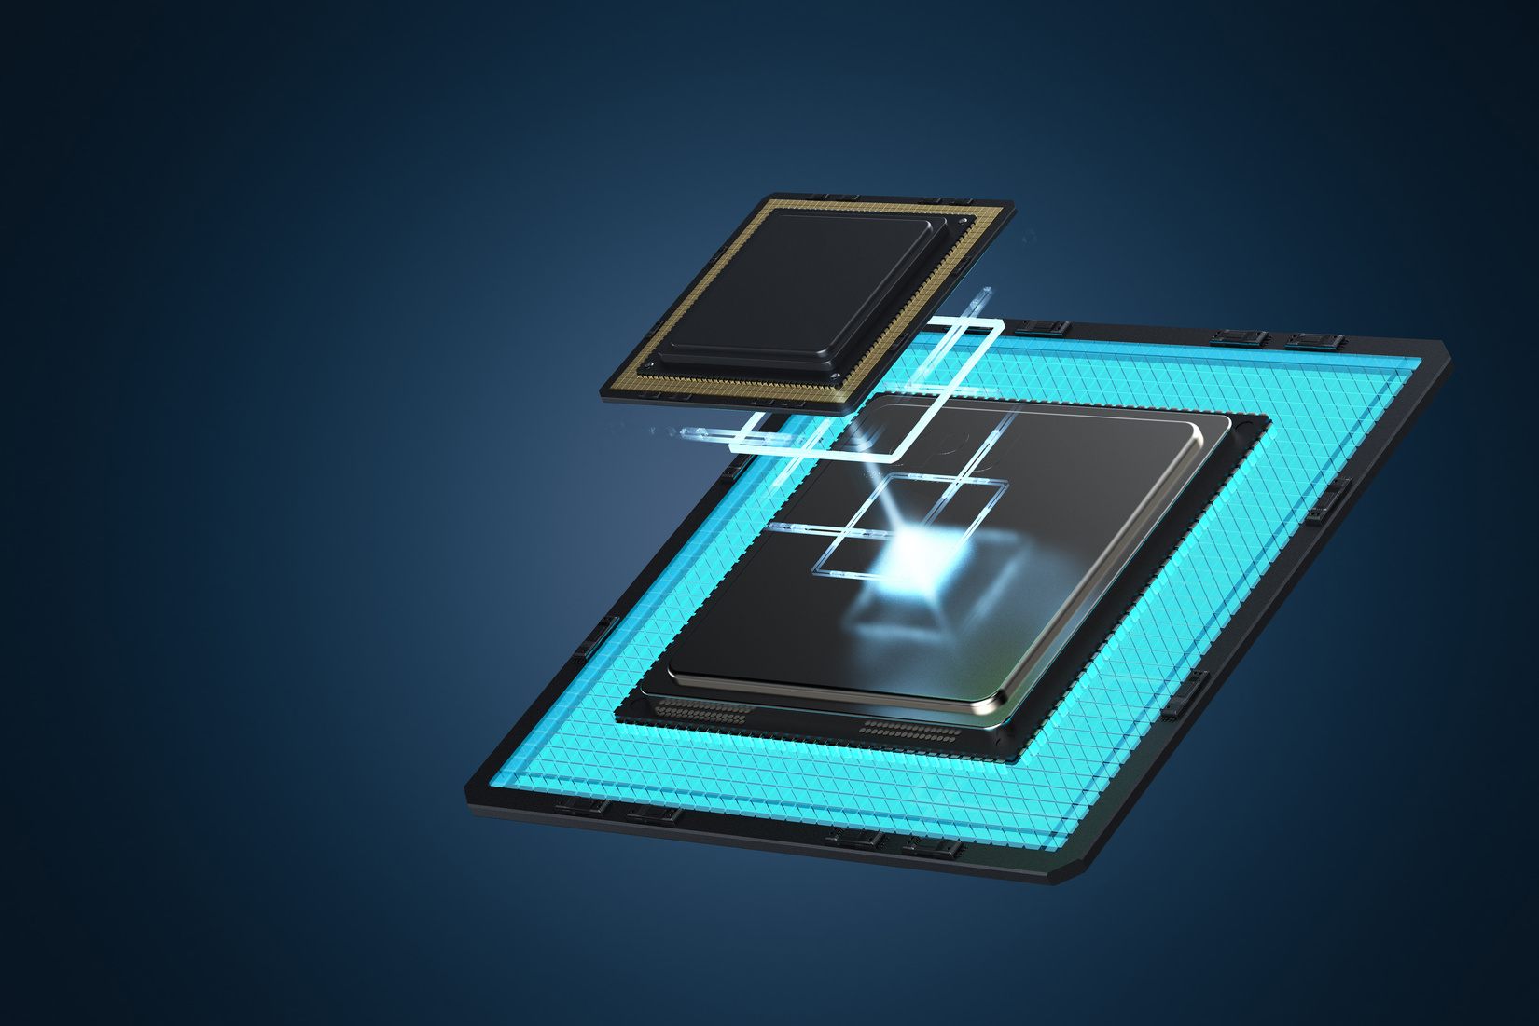
INTRODUCTION
“A PROBLEM IS THE MOTHER OF ALL INVENTIONS ''. This statement holds true in the case of Quantum computers also. Apart from man’s urge for supercomputers, it is the problem as predicted by Gordon Moore, co-founder of Intel that gave rise to the all new emerging and active branch in computers-“Quantum Computers”. The idea of Quantum computers originated in 1980 when P. Benioff thought about the Turing machine. Shor’s algorithm is the first significant problem solved by a quantum approach to excel classical computers.
Scientists already think about a quantum computer, as a next generation of classical computers. Gershenfeld says that if making transistors smaller and smaller is continued with the same rate as in the past years, then by the year of 2020, the width of a wire in a computer chip will be no more than a size of a single atom. These are sizes for which rules of classical physics no longer apply. Computers designed on today's chip technology will not continue to get cheaper and better. Because of its great power, quantum computers are an attractive next step in computer technology. Around 2030 computers might not have any transistors and chips. Theoretically it can run without energy consumption and is a billion times faster than today’s PIII computers.

Slide 3
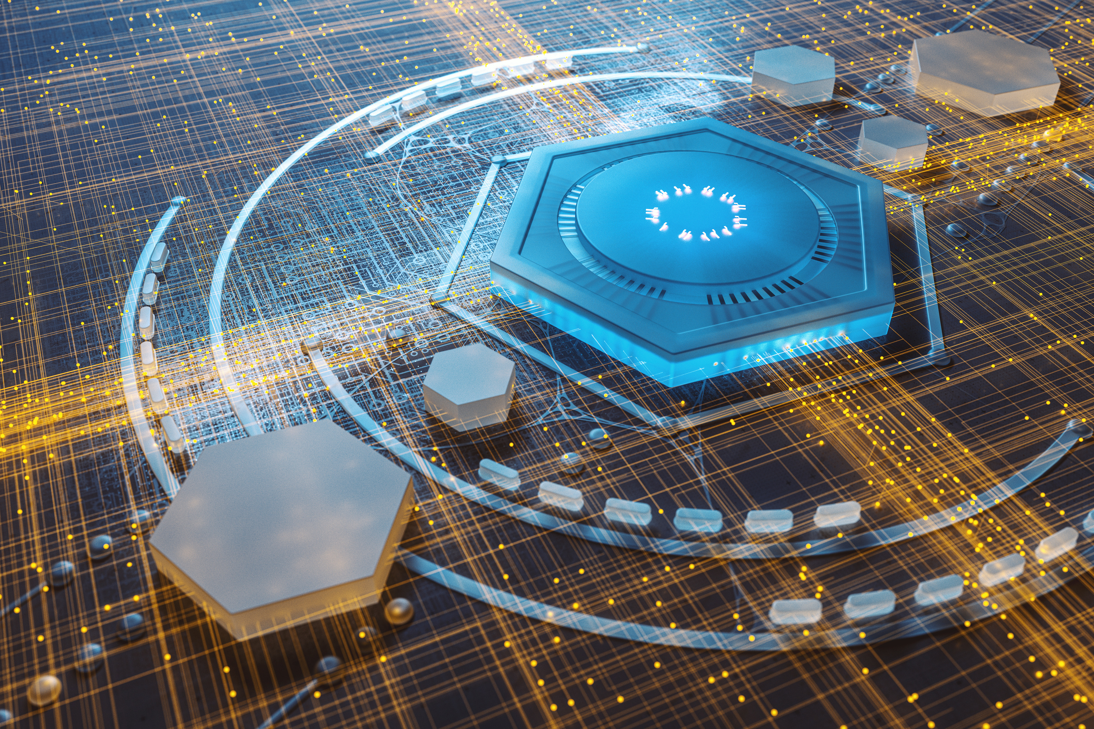


THE TECHNOLOGY OF QUANTUM COMPUTING
Quantum computers use quantum bits (qubits). Qubits have a quaternary nature. A qubit can exist not only in the states corresponding to the logical values 0 or 1 as in the case of a classical bit, but also in a superposition state. A qubit is a bit of information that can be both zero and one simultaneously (Superposition state). Thus, a computer working on a qubit rather than a standard bit can make calculations using both values simultaneously. “Multi-qubyte systems have a power beyond anything possible with classical computers.

Slide 4


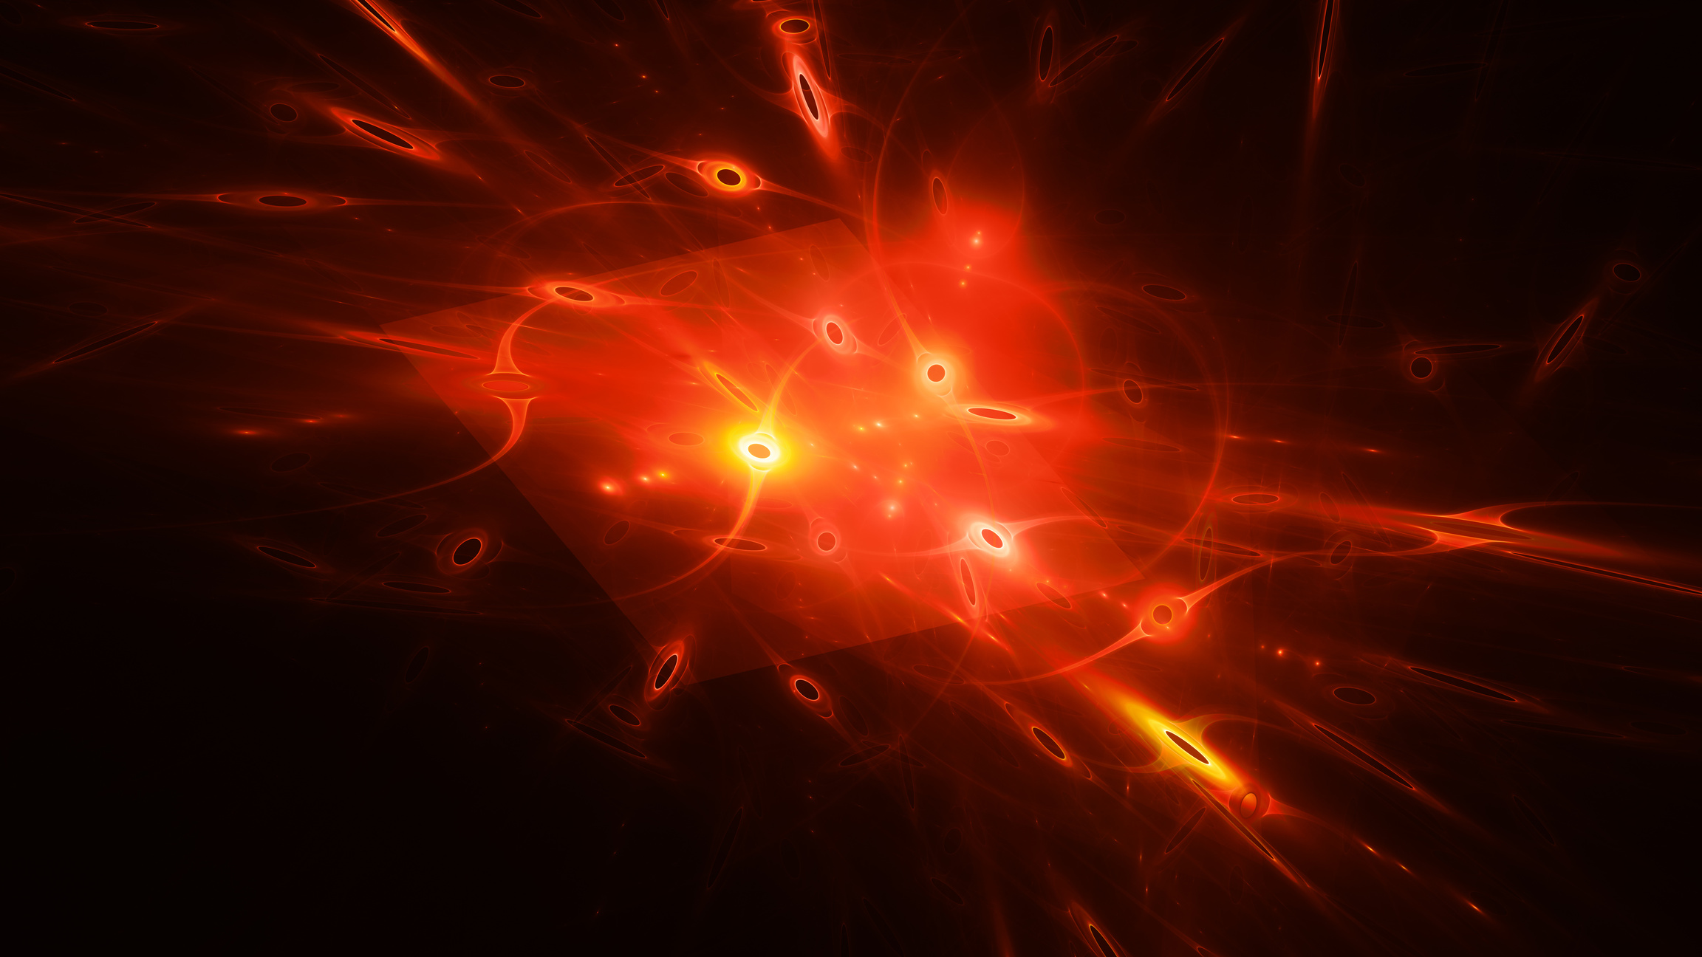

QUBITS

Slide 5
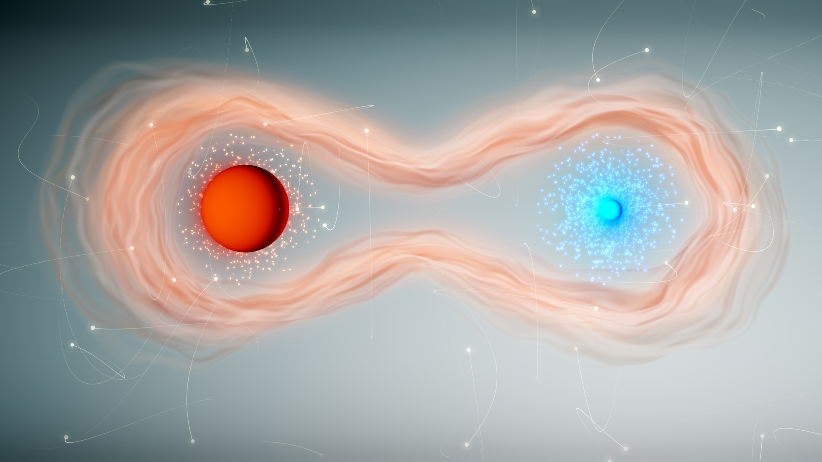


QUBIT
The basic data unit of a conventional computer is the bit. A bit stores a numerical value of either ‘0’ or ‘1’. We could also represent a bit using two different electron orbits in a single atom. In most atoms, there are many electrons in many orbits. But we need to consider only the orbits available to a single outermost electron in each atom.
However, a completely new possibility opens up for atoms. Electrons have a wave property that allows a single electron to be in two in orbits simultaneously. In other words, the electron can be in superposition of both orbits.

Slide 6
QUBIT
To distinguish this new kind of data storage, it is called quantum bit 0r qubit. The key point is that a qubit can be in a superposition of the digits ‘0’ and ‘1’. Superposition states allow many computations to be performed simultaneously, and give rise to what is known as Quantum parallelism.

Slide 7

Features
300 qubits can store more than 10^90 numbers simultaneously. That’s more than the number of atoms in the visible universe! This shows the power of quantum computers.
Integer factorization is believed to be computationally feasible with a quantum computer for large integers that are the product of only a few prime numbers (e.g., products of two 300-digit primes).
01
02
Forty qubits could have the same power as modern supercomputers. According to Chuang, a supercomputer needs about a month to find a phone number from the database consisting of the world's phone books, where a quantum computer is able to solve this task in 27 minutes. Encryption technology is a mere possibility with the help of quantum computers.
Quantum computers are reversible, and therefore there is theoretically no net energy consumption.
A quantum computer can simulate physical processes of quantum effects in real time.
03
04

Slide 8


SUPERPOSITIONING
Quantum superposition is a fundamental principle of quantum mechanics. It states that, much like waves in classical physics, any two (or more) quantum states can be added together ("superposed") and the result will be another valid quantum state; and conversely, that every quantum state can be represented as a sum of two or more other distinct states. Mathematically, it refers to a property of solutions to the Schrödinger equation; since the Schrödinger equation is linear, any linear combination of solutions will also be a solution(s) .

Slide 9
SUPERPOSITIONING
The principle of quantum superposition states that if a physical system may be in one of many configurations—arrangements of particles or fields—then the most general state is a combination of all of these possibilities, where the amount in each configuration is specified by a complex number.
For example, if there are two configurations labelled by 0 and 1, the most general state would be
c0∣0⟩+c1∣1⟩
Where the coefficients are complex numbers describing how much goes into each configuration.

Slide 10

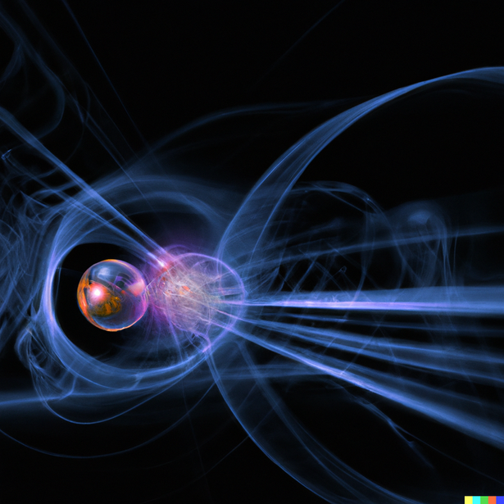
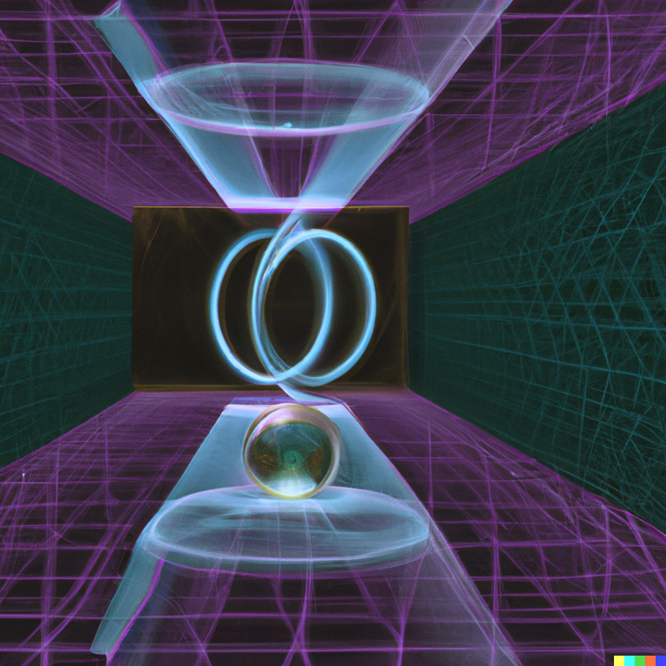

Lets take it Further
QUANTUM REGISTERS
QUANTUM PARALLELISM
QUANTUM INTERFERENCE
ENTANGLEMENT AND QUANTUM TELEPORTATION
A quantum register composed of three qubits can store in a given moment of time all eight numbers in a quantum superposition. This is quite remarkable that all eight numbers are physically present in the register but it should be no more surprising than a qubit being both in state 0 and 1 at the same time.
A one bit can store one of the digits ‘0’ and ‘1’. Likewise, a two bit memory can store one of the binary numbers ‘00’, ‘01’, ‘10’ and ‘11’. But these memories can store only a single number at a time.In contrast, a quantum superposition state allows a qubit to store ‘0’ and ‘1’ simultaneously. Two qubits can store all the four binary numbers.
The concept of Quantum interference can be explained with the famous Single particle interference effect. This says that whenever a photon is passed through a half silvered mirror it splits and the probability that the photon travels in both directions is equal. This means that the photon travels in both the directions simultaneously.
When two quantum systems are created while conserving some property, their state vectors are correlated, or entangled. For example, when two photons are created, and their spin conserved, as it must, one photon has a spin of ‘1’ and ‘-1’. By measuring one of the state vectors of the photon, the state vector collapses into a knowable state. Instantaneously and automatically, the state vector of the other photon collapses into the other knowable state. There are no forces involved and no explanation of the mechanism.

Slide 11

Applications
Ultra secure and super dense communication
01
Encryption technology
02
Improved error correction and error detection
03
04
Molecular simulations
05
True Randomness
06
Artificial Intelligence

Slide 12

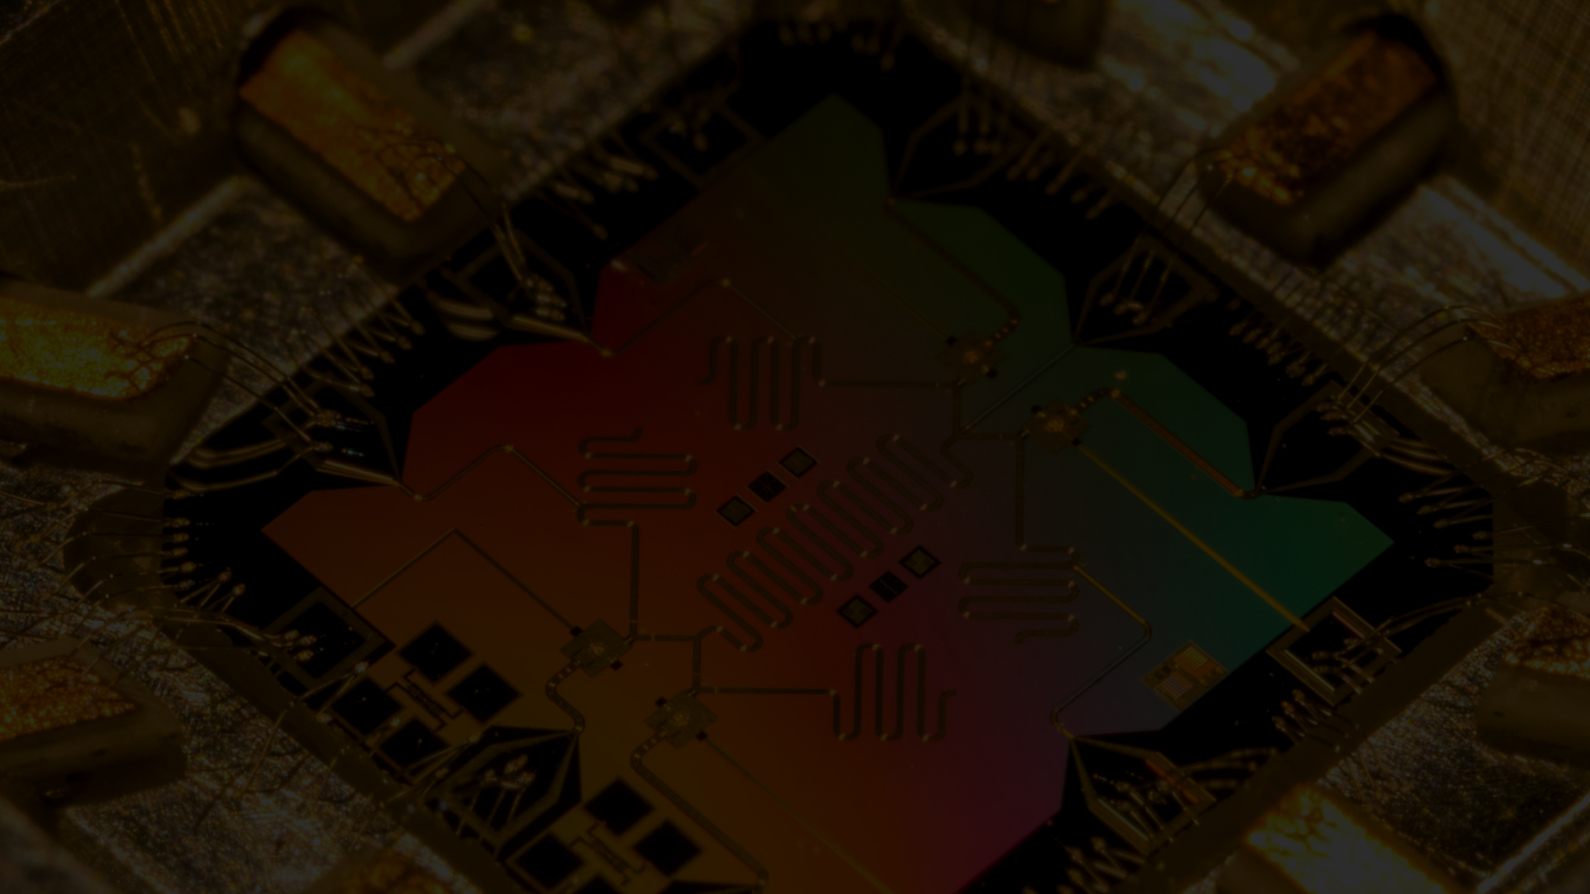
Conclusion

